Slide 1
Variables, Builtin Functions

Slide 2
Built in functions
In Python we have lots of built-in functions. Built-in functions are globally available for your use that mean you can make use of the built-in functions without importing or configuring. Some of the most commonly used Python built-in functions are the following: print(), len(), type(), int(), float(), str(), input(), list(), dict(), min(), max(), sum(), sorted(), open(), file(), help(), and dir(). In the following table you will see an exhaustive list of Python built-in functions taken from python documentation.

Slide 3
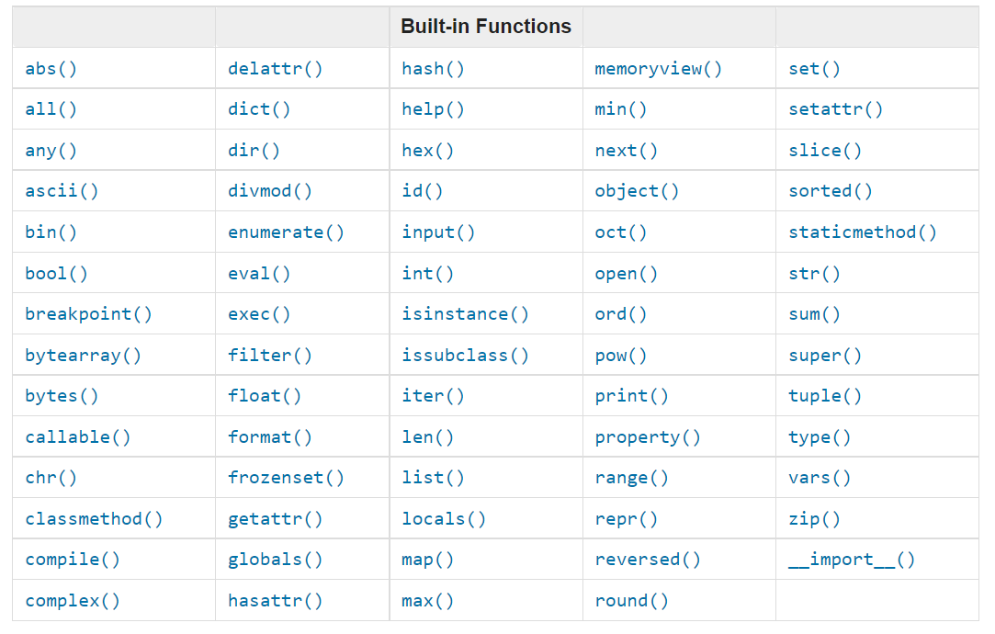

Slide 4
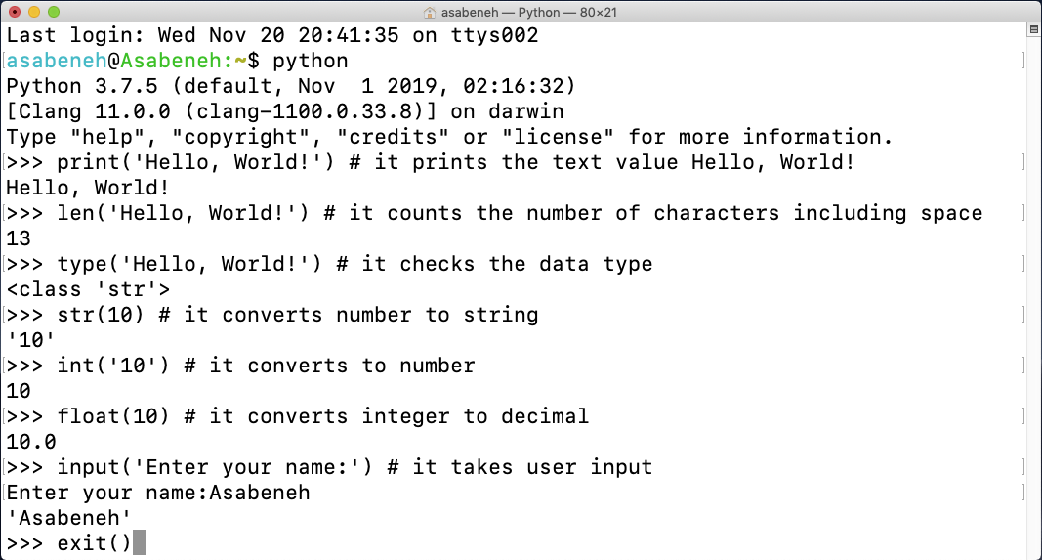
Let us open the Python shell and start using some of the most common built-in functions.

Slide 5
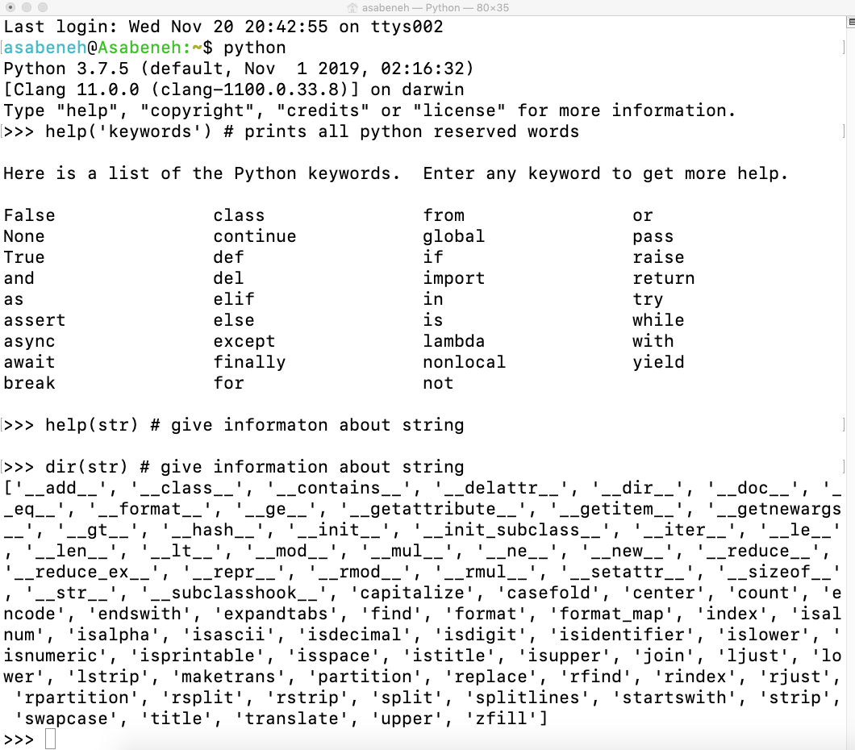
Let us practice more by using different built-in functions

Slide 6
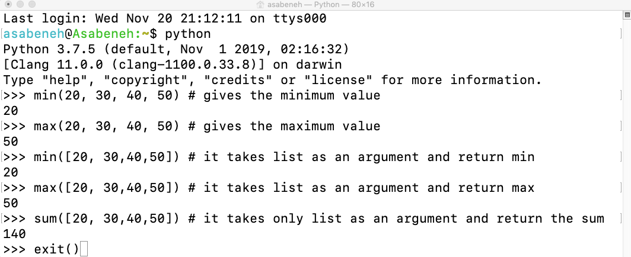
As you can see from the terminal above, Python has got reserved words. We do not use reserved words to declare variables or functions. We will cover variables in the next section.
I believe, by now you are familiar with built-in functions. Let us do one more practice of built-in functions and we will move on to the next section.

Slide 7
Variables
Variables store data in a computer memory. Mnemonic variables are recommended to use in many programming languages. A mnemonic variable is a variable name that can be easily remembered and associated. A variable refers to a memory address in which data is stored. Number at the beginning, special character, hyphen are not allowed when naming a variable. A variable can have a short name (like x, y, z), but a more descriptive name (firstname, lastname, age, country) is highly recommended.
Python Variable Name Rules
A variable name must start with a letter or the underscore character
A variable name cannot start with a number
A variable name can only contain alpha-numeric characters and underscores (A-z, 0-9, and _ )
Variable names are case-sensitive (firstname, Firstname, FirstName and FIRSTNAME) are different variables)

Slide 8
Let us see valid variable names
Firstname,Lastname,Age,country,city.
first_name,last_name,capital_city.
_if # if we want to use reserved word as a variable.
year_2021,year2021,current_year_2021.
birth_year,num1,num2.

Slide 9
Invalid variables names
first-name
first@name
first$name
num-1
1num

Slide 10
We will use standard Python variable naming style which has been adopted by many Python developers. Python developers use snake case(snake_case) variable naming convention. We use underscore character after each word for a variable containing more than one word(eg. first_name, last_name, engine_rotation_speed). The example below is an example of standard naming of variables, underscore is required when the variable name is more than one word.
When we assign a certain data type to a variable, it is called variable declaration. For instance in the example below my first name is assigned to a variable first_name. The equal sign is an assignment operator. Assigning means storing data in the variable. The equal sign in Python is not equality as in Mathematics.

Slide 11
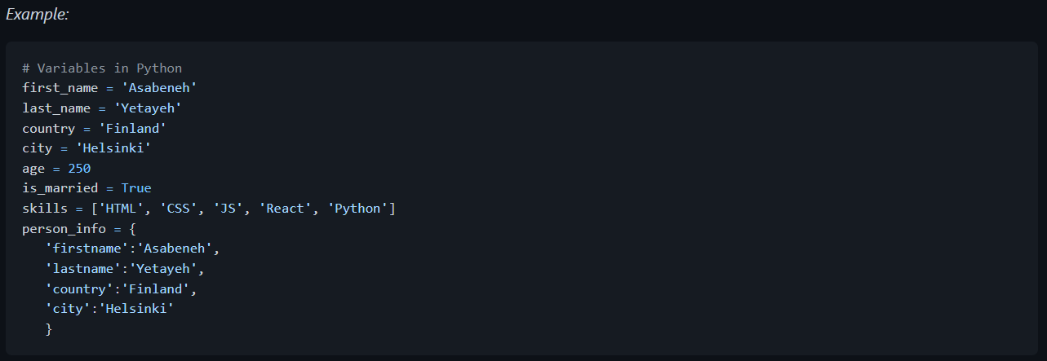

Slide 12
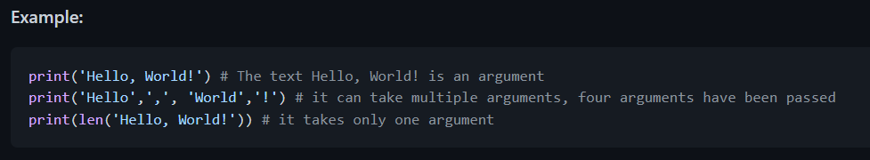
Let us use the print() and len() built-in functions. Print function takes unlimited number of arguments. An argument is a value which we can be passed or put inside the function parenthesis, see the example below.

Slide 13
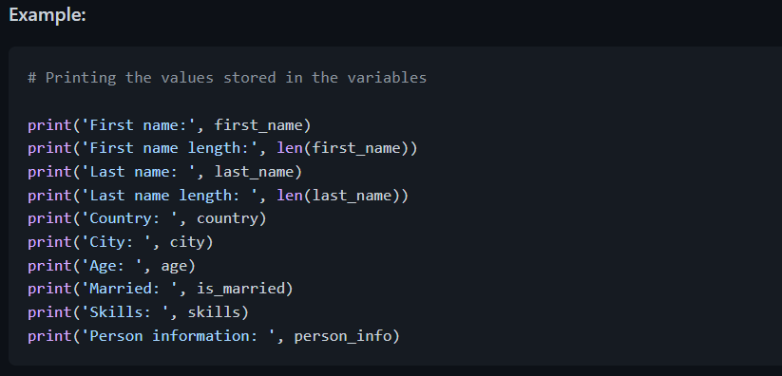
Let us print and also find the length of the variables declared at the top:

Slide 14
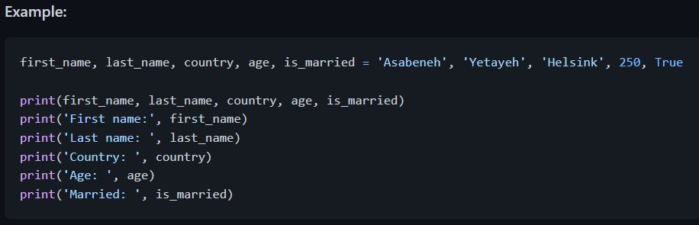
Declaring Multiple Variable in a Line
Multiple variables can also be declared in one line:

Slide 15
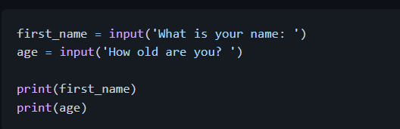
Getting user input using the input() built-in function. Let us assign the data we get from a user into first_name and age variables. Example:

Slide 16
Data Types:
There are several data types in Python. To identify the data type we use the type built-in function. I would like to ask you to focus on understanding different data types very well. When it comes to programming, it is all about data types. I introduced data types at the very beginning and it comes again, because every topic is related to data types. We will cover data types in more detail in their respective sections.

Slide 17
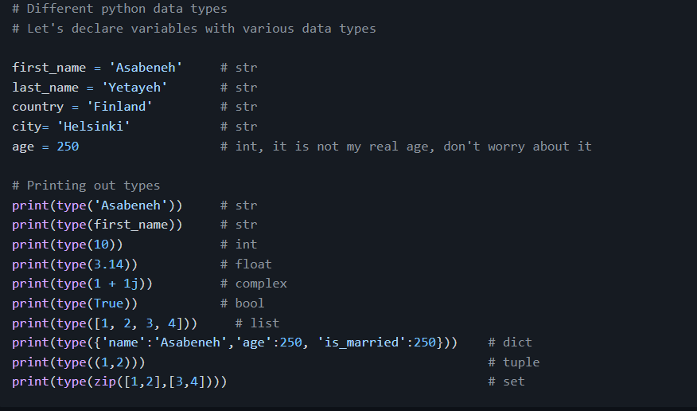
Checking Data types and Casting
Check Data types: To check the data type of certain data/variable we use the type Example:

Slide 18
Casting: Converting one data type to another data type. We use int(), float(), str(), list, set When we do arithmetic operations string numbers should be first converted to int or float otherwise it will return an error. If we concatenate a number with a string, the number should be first converted to a string. We will talk about concatenation in String section.

Slide 19
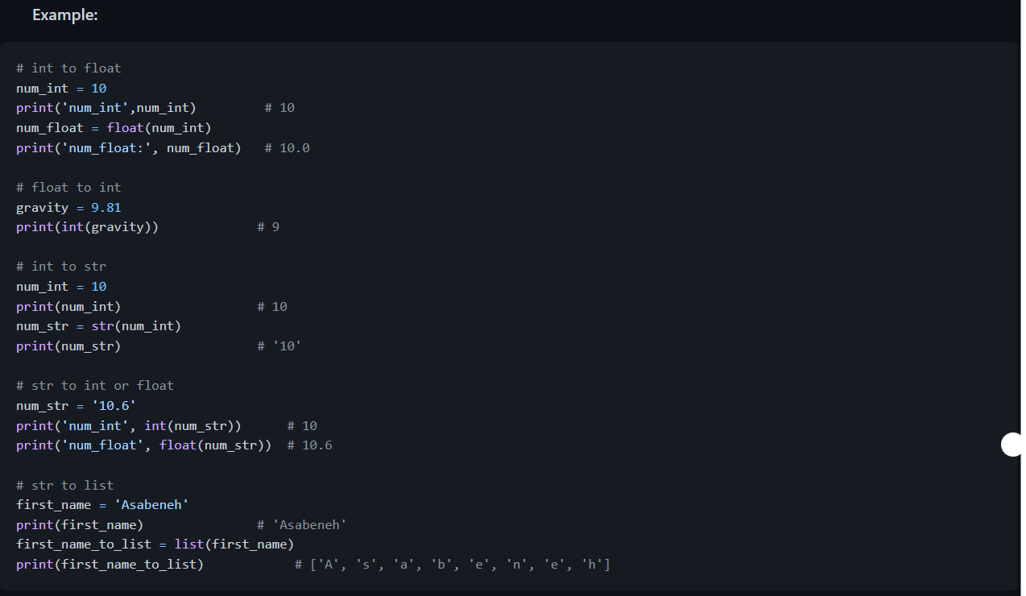

Slide 20
Numbers
Number data types in Python:
Integers: Integer(negative, zero and positive) numbers Example: ... -3, -2, -1, 0, 1, 2, 3 ...
Floating Point Numbers(Decimal numbers) Example: ... -3.5, -2.25, -1.0, 0.0, 1.1, 2.2, 3.5 ...
Complex Numbers Example: 1 + j, 2 + 4j, 1 - 1j
🌕 You are awesome. You have just completed day 2 challenges and you are two steps ahead on your way to greatness. Now do some exercises for your brain and muscles.

Slide 21
Exercises - Day 2
Inside 30DaysOfPython create a folder called day_2. Inside this folder create a file named variables.py
Write a python comment saying 'Day 2: 30 Days of python programming'
Declare a first name variable and assign a value to it
Declare a last name variable and assign a value to it
Declare a full name variable and assign a value to it
Declare a country variable and assign a value to it
Declare a city variable and assign a value to it

Slide 22
Declare an age variable and assign a value to it
Declare a year variable and assign a value to it
Declare a variable is_married and assign a value to it
Declare a variable is_true and assign a value to it
Declare a variable is_light_on and assign a value to it
Declare multiple variable on one line

Slide 23
Exercises: Level 2:
Check the data type of all your variables using type() built-in function
Using the len() built-in function, find the length of your first name
Compare the length of your first name and your last name
Declare 5 as num_one and 4 as num_two
Add num_one and num_two and assign the value to a variable total
Subtract num_two from num_one and assign the value to a variable diff
Multiply num_two and num_one and assign the value to a variable product
Divide num_one by num_two and assign the value to a variable division
Use modulus division to find num_two divided by num_one and assign the value to a variable remainder
Calculate num_one to the power of num_two and assign the value to a variable exp
Find floor division of num_one by num_two and assign the value to a variable floor_division

Slide 24
The radius of a circle is 30 meters.
Calculate the area of a circle and assign the value to a variable name of area_of_circle
Calculate the circumference of a circle and assign the value to a variable name of circum_of_circle
Take radius as user input and calculate the area.
Use the built-in input function to get first name, last name, country and age from a user and store the value to their corresponding variable names
Run help('keywords') in Python shell or in your file to check for the Python reserved words or keywords

